Slide 1
Fourier Transforms and Methods
PHYS3112 – Tutorial 3

Slide 2
Today we will:
Learn about the Fourier transform
Learn how to apply the FFT to everything
Design an image filter using 2D Fourier transforms

Slide 3
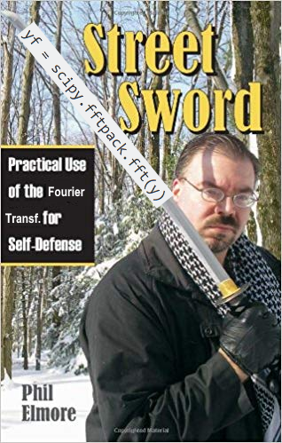

You have probably heard of the Fourier Transform!

Slide 4
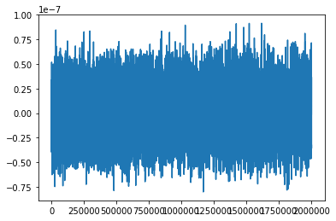
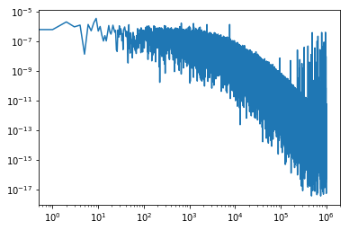
What is the Fourier Transform?
Transforms a signal from time-space to frequency space.
I.e. it displays the frequencies present in a signal.
Complicated Maths!
Inside the Coupled Pendulum Lab!
TIME
“Frequency”

Slide 5
Implementing the Fourier Transform
We will use the Fast Fourier Transform (FFT).
It’s fast – without it, Fourier analysis wouldn’t be as prevalent as it is today.
Call it by passing the time series (as a 1D vector) into the FFT function.
We will be using functions from scipy’s ‘fftpack’. The basic one is scipy.fftpack.fft
FFT
x(t)
X(s)

Slide 6
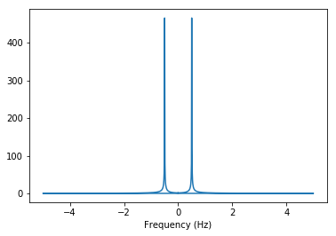
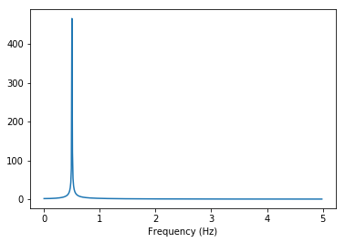
Fourier Jank!
The fourier transform returns complex numbers – so be certain to take the absolute value!
The fourier transform also returns a vector that is centered at frequency = 0, so normally you just take the second half of the data.

Slide 7
Generating Your Frequency Base
The FFT Spits out a vector without a corresponding frequency base.
The frequency vector depends on your sampling rate (timestep) and number of samples
Fortunately numpy and scipy can make this for you using the ‘fftfreq’ command.
What frequencies does this correspond to?

Slide 8
Resolution!
Rule of Thumb: To see low frequencies, sample longer. To see high frequencies, sample FASTER.
If you can’t sample for a longer period of time (i.e. you ALREADY GATHERED YOUR COUPLED PENDULUM DATA), then you can zero-pad your data (add a bunch of zeroes to the end!)
You can try this out in the tutorial!

Slide 9
Further Reading:
‘Elegant SciPy Ch4 - Frequency and the Fast Fourier Transform’
https://learning.oreilly.com/library/view/elegant-scipy/9781491922927/ch04.html

Slide 10
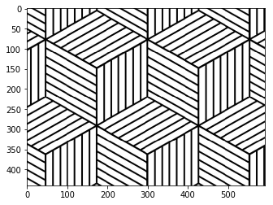
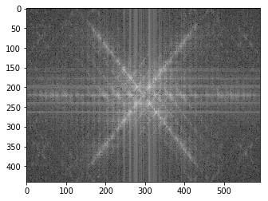
The 2D Fourier Transform
You can also fourier transform images.
The result here is the 2D representation of the frequency components of the signal.

Slide 11
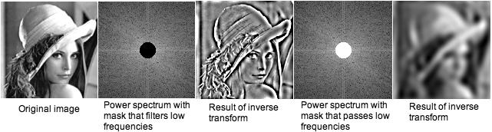
Image Noise Filtering
By messing with the fourier-space, you can make changes to the image
This can be used in image processing – if the noise has a HIGH spatial frequency, you can take only the lower frequencies and ignore the noise!
(This is especially good for noise with regular frequencies)

Slide 12
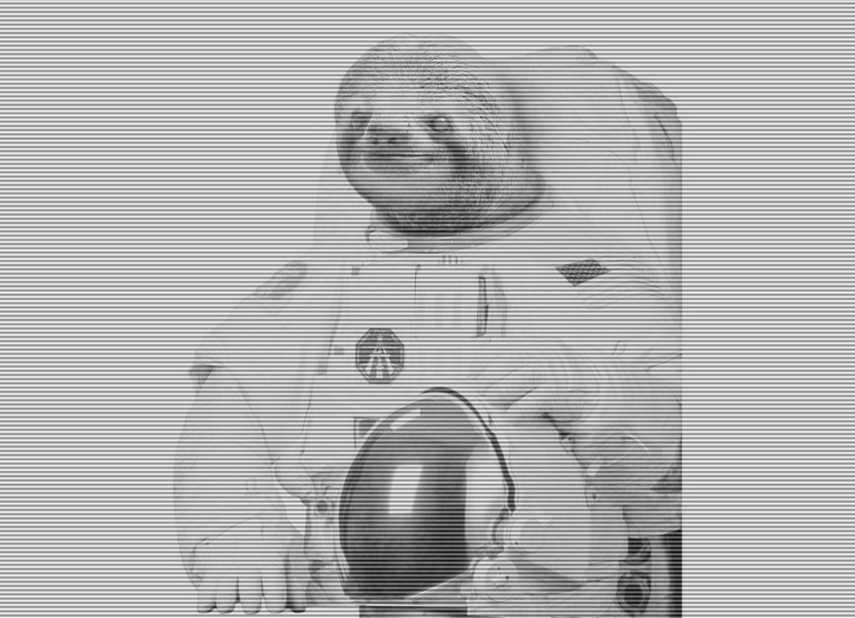
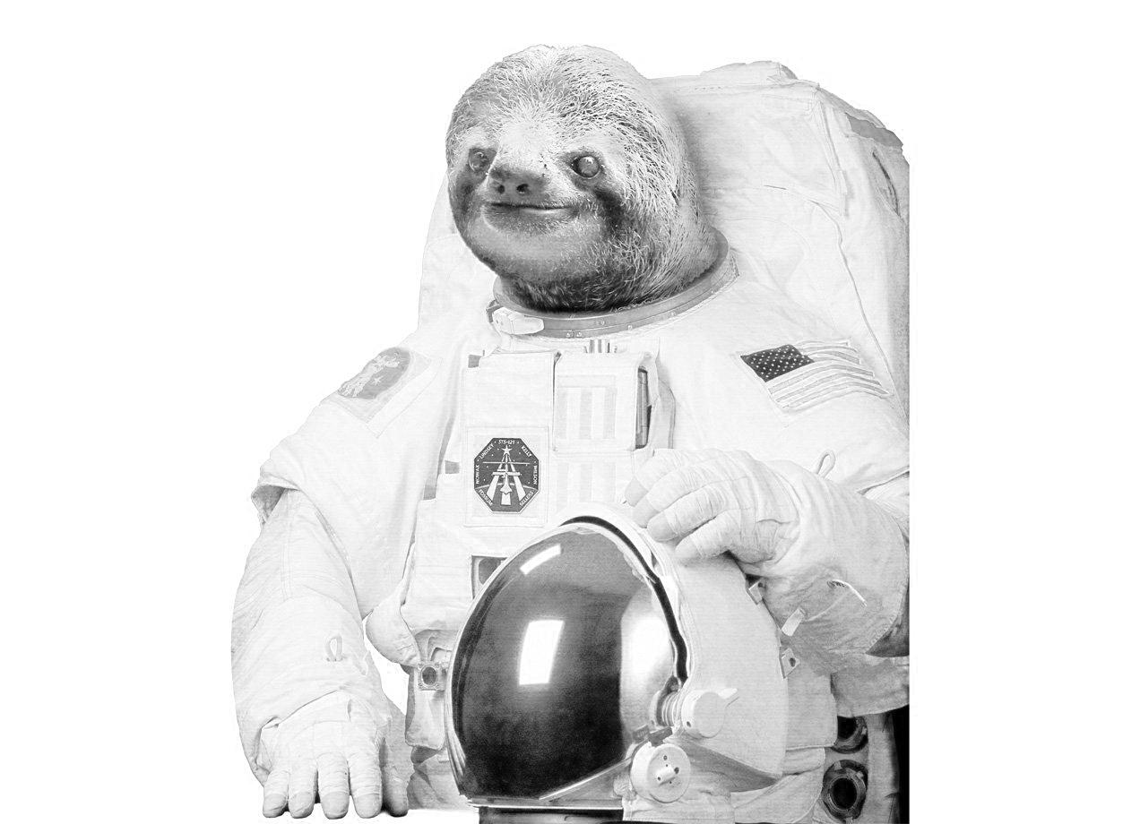
Your Goal:

